Slide 1
String and StringBuilder in C#

Slide 2
Array in C#
An array is a group of like-typed variables that are referred to by a common name.
In C# the allocation of memory for the arrays is done dynamically.
Length of the array specifies the number of elements present in the array.
Arrays in C# work differently than they do in C/C++.

Slide 3
Important Points to Remember About Arrays in C#

Slide 4
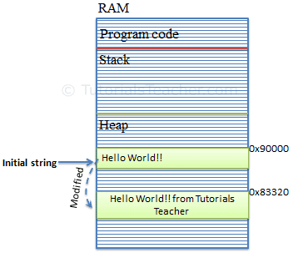
String
String is immutable
ie can’t change once created
String s1=“Hello World!!”
s1=s1+”from Tutorials Teacher”
Console.WriteLine(s1);
Output : Hello World!!from Tutorials Teacher

Slide 5
C# String methods
Method Name | Description
Compare(String, String) | It is used to compares two specified String objects. It returns an integer that indicates their relative position in the sort order.
CompareTo(String) | It is used to compare this instance with a specified String object. It indicates whether this instance precedes, follows, or appears in the same position in the sort order as the specified string.
Concat(String, String) | It is used to concatenate two specified instances of String.
Contains(String) | It is used to return a value indicating whether a specified substring occurs within this string.

Slide 6
CopyTo(Int32, Char[], Int32, Int32) | It is used to copy a specified number of characters from a specified position in this instance to a specified position in an array of Unicode characters.
IndexOf(String) | It is used to report the zero-based index of the first occurrence of the specified string in this instance.
Insert(Int32, String) | It is used to return a new string in which a specified string is inserted at a specified index position.
Join(String, String[]) (Method of string class) | It is used to concatenate all the elements of a string array, using the specified separator between each element.
Split(Char[]) | It is used to split a string into substrings that are based on the characters in an array.
ToCharArray() | It is used to copy the characters in this instance to a Unicode character array.
Trim() | It is used to remove all leading and trailing white-space characters from the current String object.

Slide 7
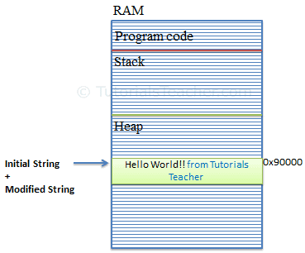
StringBuilder
StringBuilder is mutable class
StringBuilder s1=new StringBuilder(“Hello World!!”);
S1.append(”from Tutorials Teacher”);
Console.WriteLine(s1.toString());

Slide 8
Retrieve String from StringBuilder
StringBuilder sb = new StringBuilder("Hello World!");
var greet = sb.ToString(); //returns "Hello World!"
Add/Append String to StringBuilder
StringBuilder sb = new StringBuilder();
sb.Append("Hello ");
sb.AppendLine("World!");
sb.AppendLine("Hello C#");

Slide 9
Insert String into StringBuilder
StringBuilder sb = new StringBuilder("Hello World!");
sb.Insert(5," C#");
Console.WriteLine(sb); //output: Hello C# World!
Remove String in StringBuilder
StringBuilder sb = new StringBuilder("Hello World!",50);
sb.Remove(6, 7);
Console.WriteLine(sb); //output: Hello

Slide 10
Replace String in StringBuilder
StringBuilder sb = new StringBuilder("Hello World!"); sb.Replace("World", "C#"); Console.WriteLine(sb);//output: Hello C#!

